Slide 1
Summarization
Natural Language Processing with Transformers
Building Language Applications with Hugging Face
이용환

Slide 2
Dataset
The CNN/DailyMail Dataset

Slide 3
The CNN/DailyMail Dataset
약 30만개의 뉴스 기사와 대응되는 요약문(CNN과 DailyMail이 기사에 첨부한 중요 내용으로 구성된 )의 쌍으로 구성된 dataset
Summary는 단순한 발췌문이 아닌 새로운 문장들로 구성되어 있다.
이 책에서는 Huggingface에서 version 3.0.0을 사용한다.
Code
from datasets import load_dataset
dataset = load_dataset("cnn_dailymail", version="3.0.0")
print(f"Features: {dataset['train'].column_names}")
Output
Features: ['article', 'highlights', 'id']
이 dataset은 3개의 column으로 구성되어 있다.
article : 뉴스 기사, highlight : 요약문, id : 각 article마다 부여된 String

Slide 4
The CNN/DailyMail Dataset
Code
sample = dataset["train"][1]
print(f"""
Article (excerpt of 500 characters, total length: {len(sample["article"])}):
""")
print(sample["article"][:500])
print(f'\nSummary (length: {len(sample["highlights"])}):')
print(sample["highlights"])
Output
Article (excerpt of 500 characters, total length: 4051):
Editor's note: In our Behind the Scenes series, CNN correspondents share their experiences in covering news and analyze the stories behind the events. Here, Soledad O'Brien takes users inside a jail where many of the inmates are mentally ill. An inmate housed on the "forgotten floor," where many
mentally ill inmates are housed in Miami before trial. MIAMI, Florida (CNN) -- The ninth floor of the Miami-Dade pretrial detention facility is dubbed the "forgotten floor." Here, inmates with the most s
Summary (length: 281):
Mentally ill inmates in Miami are housed on the "forgotten floor"
Judge Steven Leifman says most are there as a result of "avoidable felonies"
While CNN tours facility, patient shouts: "I am the son of the president"
Leifman says the system is unjust and he's fighting for change .

Slide 5
The CNN/DailyMail Dataset
train, validation, test로 나누어져 있음
각 데이터 수
Dataset Split | Number of Instances in Split
Train | 287,113
Validation | 13,368
Test | 11,490

Slide 6
Text Summarization
with Huggingface Pipelines

Slide 7
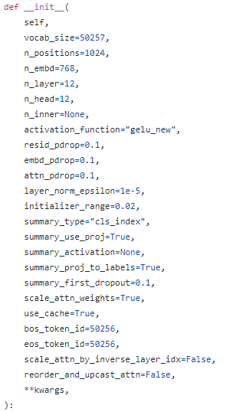
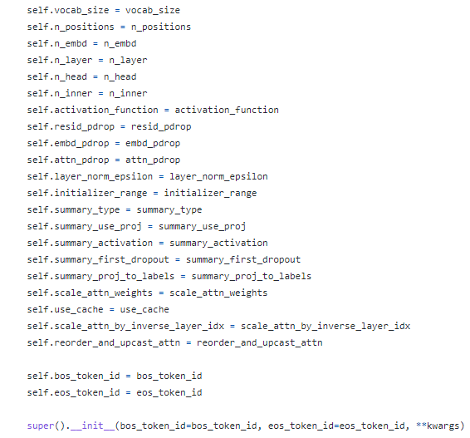
GPT2Config

Slide 8
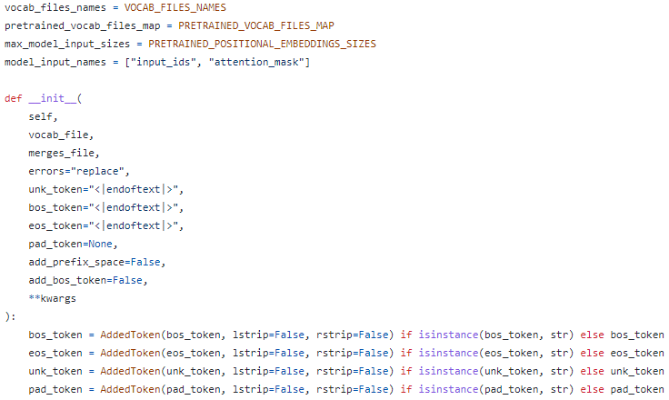
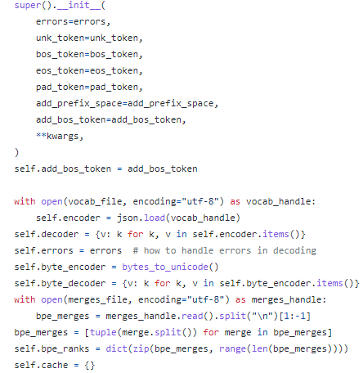
GPT2Tokenizer

Slide 9
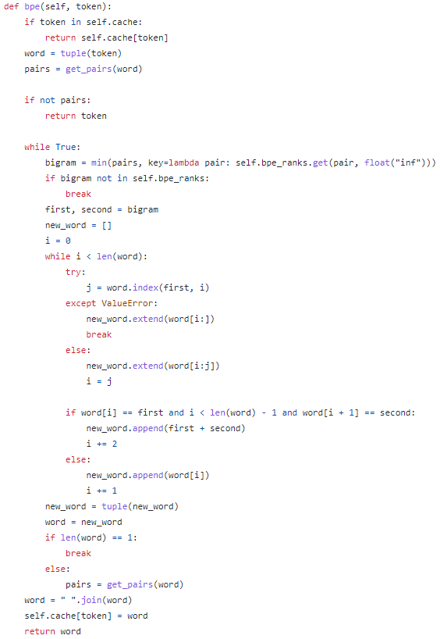

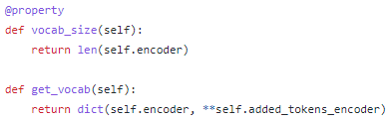
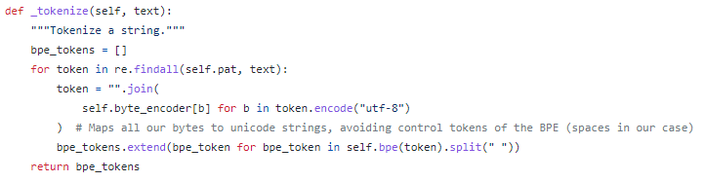
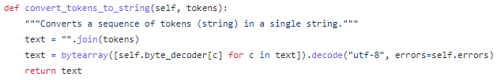
GPT2Tokenizer

Slide 10
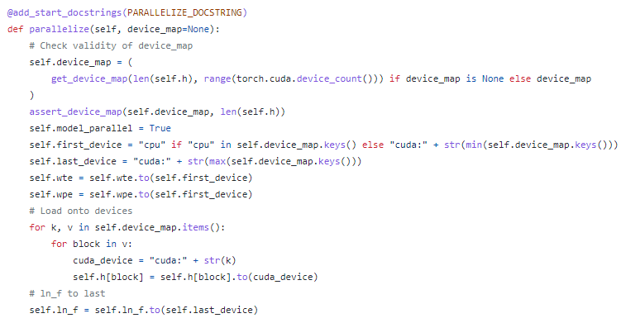
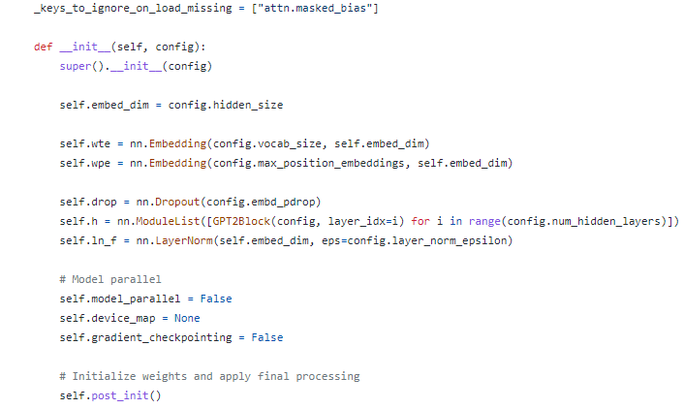
GPT2Model

Slide 11
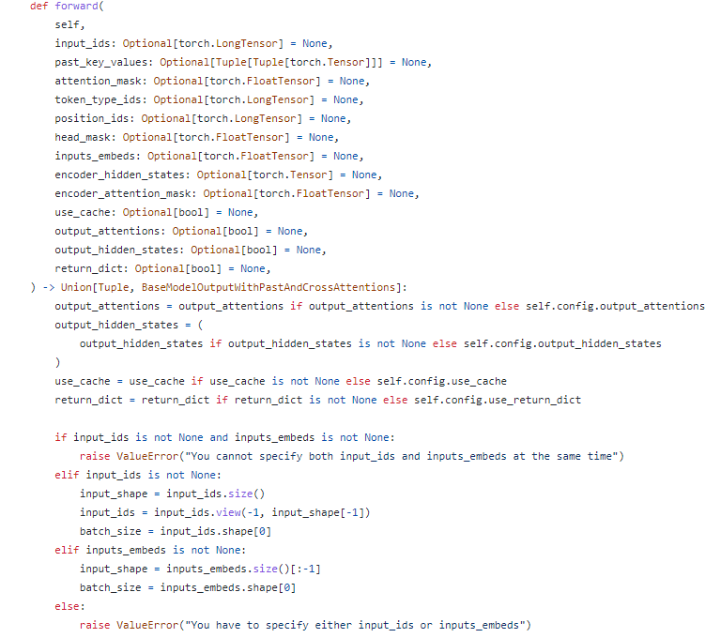
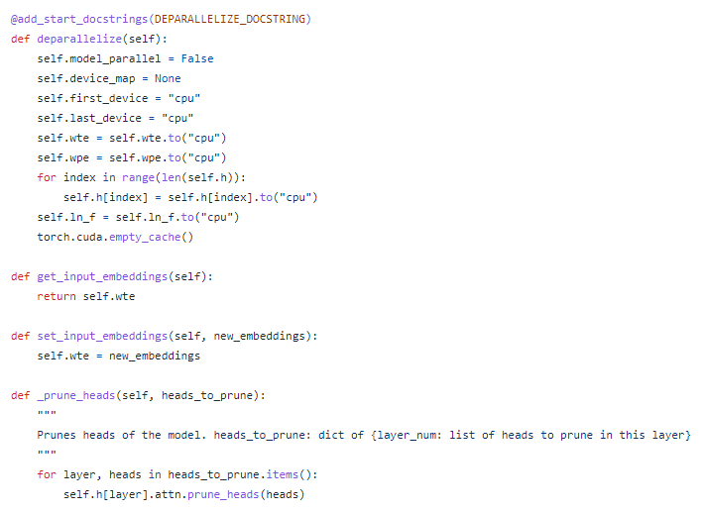
GPT2Model

Slide 12
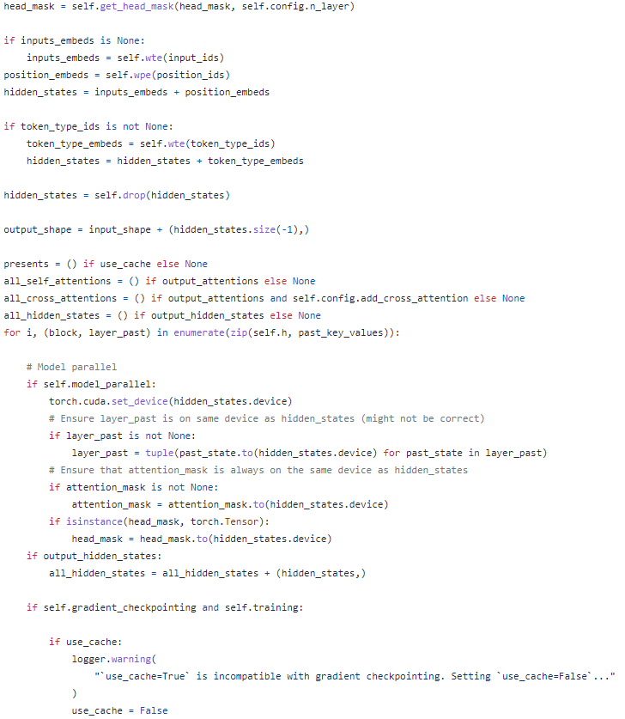
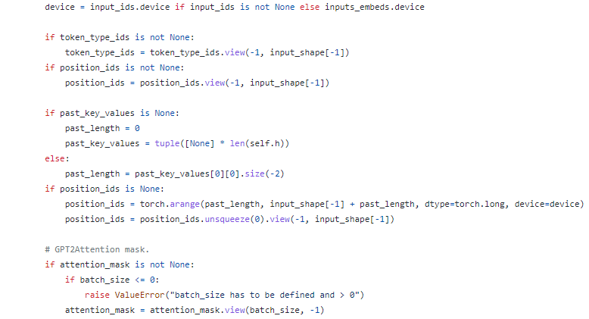
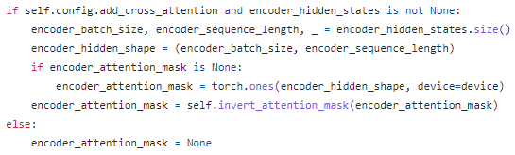
GPT2Model

Slide 13
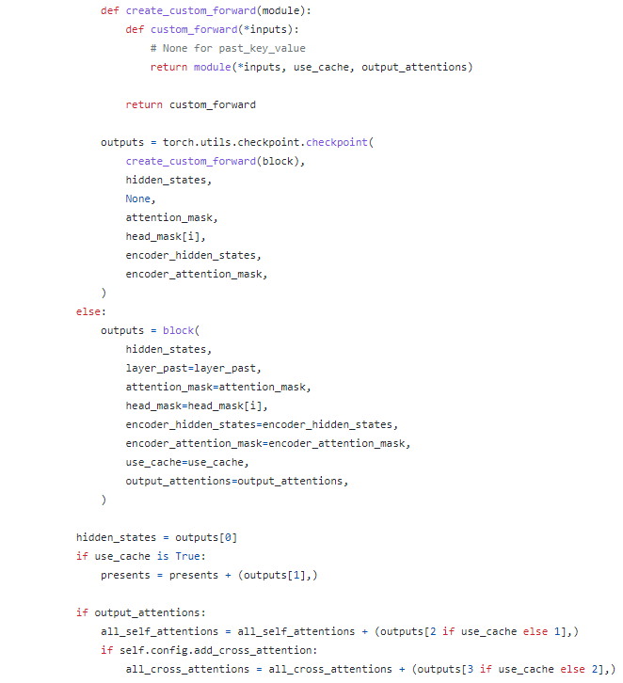

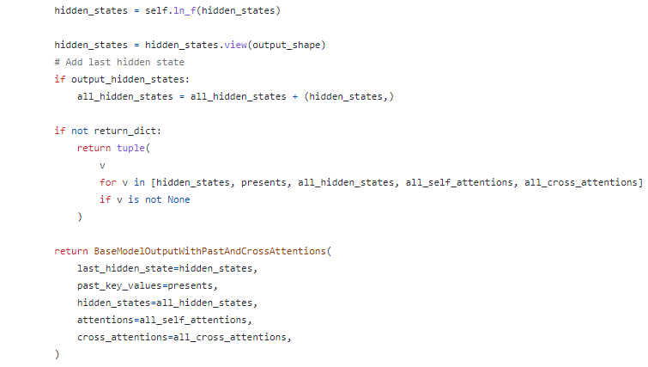
GPT2Model

Slide 14
GPT2Model

Slide 15
Measuring the Quality
Measurement Indicators

Slide 16
Training a Summarization Model
PEGASUS

